Slide 1
EMPOWER A combination HIV prevention intervention that includes oral PrEP for adolescent girls and young women in South Africa and Tanzania
Sinead Delany-Moretlwe
EHPSA satellite, IAS 2018, Amsterdam
Notes:
Good morning
I am going to talk to you about EMPOWER – a combination

Slide 2
The issue
Adolescent girls and young women are at high risk for HIV infection in sub-Saharan Africa
Gender-based violence increases the risk of HIV acquisition
One-third of women globally experience physical and/or sexual violence by partner
Gender-based violence and harmful gender norms undermine HIV testing, treatment initiation and continuation in care
UNAIDS, 2017; Li, 2014; WHO, 2013; Hatcher, 2015

Slide 3
Oral PrEP for HIV prevention
TDF/FTC licensed for PrEP in >40 countries
Included in WHO Essential Medicines List
Roll-out to priority populations
Questions about models of PrEP delivery
Focus on strategies to maximise adherence
WHO, 2015; www.prepwatch.org
Notes:
Recommendations based on systematic review of 12 randomised controlled trials of oral PrEP effectiveness conducted in a range of different populations worldwide
PrEP was effective in reducing HIV risk across age, gender, ARV regimen (TDF versus emtricitabine (FTC) + TDF) or mode of acquiring HIV (rectal or penile/ vaginal).

Slide 4
Violence: potential barrier to PrEP use
Male partners’ understanding or support of the trial and study products had a significant influence on women’s use of PrEP
Fear of disclosure to partner
Disclosure however associated with better adherence
ART use perceived to be associated with HIV illness by male partners;
Concerns about potential stigma led to concealed use of study products and lower adherence;
unintentional disclosure occasionally led to relationship conflicts
Source: Marrazzo, 2015; Montgomery, 2014; van der Straten, 2014a; van der Straten, 2014b Stadler, 2014; Succop, 2014; Mngadi,2014

Slide 5
Prevention of violence against women and girls – the evidence
Ineffective
Promising
Insufficient evidence
Conflicting
Men and boys gender norms programming
Economic empowerment
Awareness raising campaigns
Personnel training
Justice and law enforcement responses
One-stop crisis centres
Women’s police stations
Perpetrator programmes
Social marketing
Alternative rights of passage
Home visitation
Infrastructure/transport
ICT services
Community mobilisation
Empowerment training for women and girls
Group training for women and men
Microfinance/ cash transfers + gender training
Source: Ellsberg, 2014

Slide 6
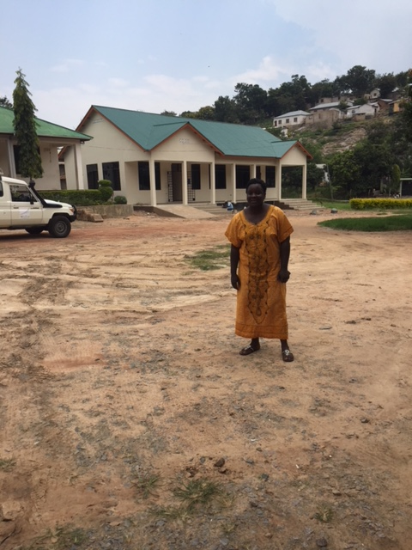
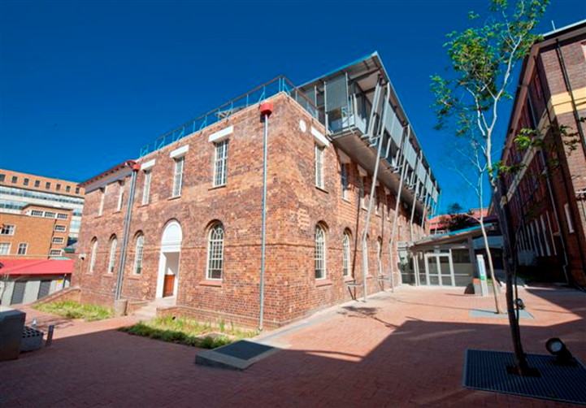
Research question
Is it feasible, acceptable and safe to integrate responses to gender-based violence and harmful norms into an HIV prevention programme offering PrEP for AGYW aged 16-24 years?
Johannesburg, South Africa
Mwanza, Tanzania

Slide 7
Designing a combination HIV prevention programme
HIV testing
Offer PrEP
PrEP continuation
Demand creation for HIV prevention
PrEP decision Counselling
PrEP as part of a comprehensive sexual and reproductive health service delivered in a youth friendly clinic
Counselling and SMS

Slide 8
Designing a combination HIV prevention programme
HIV testing
Offer PrEP
PrEP continuation
GBV screening integrated into
HIV testing
Community dialogues
PrEP as part of a comprehensive sexual and reproductive health service delivered in a youth friendly clinic
Clubs with an empowerment
curriculum

Slide 9
1. GBV screening process

Slide 10
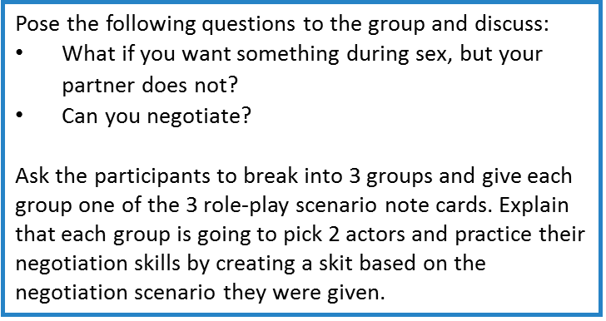
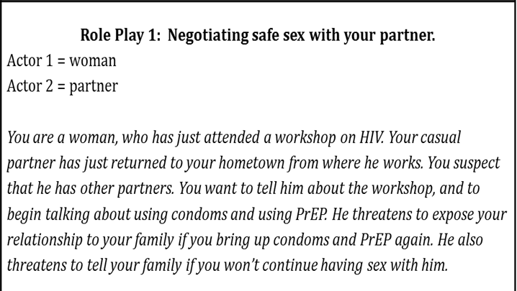
2. Empowerment clubs
Literature review
Adaption of materials from existing programmes
Pilot testing during training of facilitators
Session 1: Gender Roles & Social Norms
Session 2: Power and Control
Session 3: Sexual Reproductive Health
Session 4: Empowerment
Notes:
Lit review on existing materials on Community-based treatment support groups conducted and material were developed and adapted from Youth care clubs model and existing violence and stigma prevention programs for inclusion in the EMPOWER clubs.
A four session curriculum was developed:
Where session 1 aims to address how gender norms and roles are formed and can be harmful
Session2 looks at how various types of power presents in their daily lives and the main types of violence
Session3 then aims to teach the girls to recognise PrEP stigma as an obstacle to PrEP adherence. And we also talk about negotiating safe sex practices with boyfriends/partners in this session
The session on empowerment looks at ignoring negative influence in their lives and setting goals for the future

Slide 11
Club format
Sessions were sequentially structured
Non-clinic venue
Led by a trained facilitator
One session per month; duration 2 hours
Weekday afternoon and Saturday mornings
Planned 20 members per club
Notes:
Sessions are sequentially structured- in that participants do not attend session 2 if S1 is missed
Participants gathered at the adolescent clinic and are then moved to a venue away from the clinic setting to create a safe space for conversation
Clubs take an average of 2 hours per session- data from SISTA South Africa RCT provides some reassurance that even with as few as three 2. 5 hour sessions; increasing knowledge, greater relationship control and more accepting attitudes towards HIV stigma are possible
15-20 participants are invited at a time

Slide 12
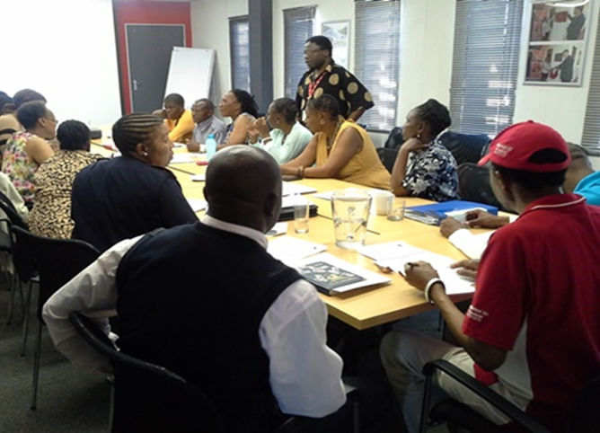
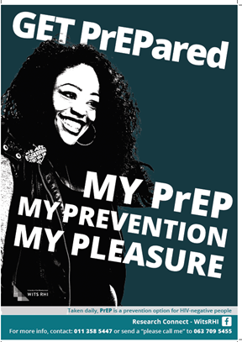
3. Community dialogues
Based on SASA! Model
Promote community discussion about healthy sexual relationships
Used materials from clubs
Highlighted importance of adult stakeholders
Need for informational materials

Slide 13
Evaluation framework
Clinical data collection: HIV, GBV outcomes, safety, pill returns, adherence
Screening
Enrolment
M1
M3
M6, 9, 12
Baseline survey
Exit
survey
Qualitative interviews with participants n=25 X 3
Qualitative interviews with providers
Qualitative interviews with community stakeholders
Observations: clinic, clubs, community dialogues

Slide 14
Results
Results will be presented at IAS, 2018
Session Title: Confronting violence against women Session Date: Thursday, 26 July 2018 Session Time: 14:30-16:00
Session title: Differentiated service delivery models Session date: Friday, 27 July 2018 Session time: 11:00-12:30
Poster: Lees, et al. Understanding motives for initiating PrEP amongst adolescent girls and young women in South Africa and Tanzania

Slide 15
Key learnings
Young women in SA and Tz are at high risk for HIV and GBV
Young women recognise their risk and are interested in PrEP
Youth engagement in the design of services and interventions is critical
Provision of services that are confidential, respectful, and non-judgement are highly acceptable to youth – and feasible to deliver
Partnerships across sectors are particularly important for developing referral pathways for young people

Slide 16
Acknowledgements Participants and communities Site study teams
Fiona Scorgie
Matthew Chersich
Deborah Baron
Niven Naicker
Keo Makgamathe
Viv Findlay
Helen Rees
Sheila Harvey
Manuela Columbini
Saidi Kapiga
Charlotte Watts
Anne Stangl
Jennifer Schutzman
Iman Barre
Charlotte Watts
This work was made possible by EHPSA
Wits RHI is an SA MRC collaborating centre
We acknowledge the contribution of the STRIVE consortium to this work

